Slide 1

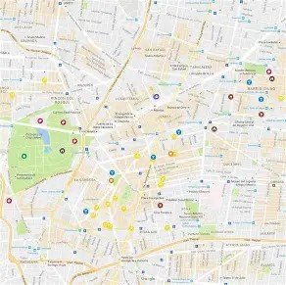
IP Location Finder
A Simple Geolocation AppIPInfo React Leaflet
Name: Devin Chidozie
Matric No: Vug/Sen/24/11438

Slide 2
What the App Does
Tracks and displays the geographic location of any IP address
Uses IPInfo API to fetch IP data (like city, region, and coordinates)
Displays that data on an interactive OpenStreetMap
Built with: React, Leaflet, and Fetch API

Slide 3
Methodology: How the App Works
1. User Input:
User enters any valid IP address (e.g., 8.8.8.8)
2. Fetch IP Info:
App calls https://ipinfo.io/{ip}?token='d9b4751ba83a5f'
Gets location string like "6.5244,3.3792"
3. Parse Data:
Extract latitude and longitude from the response
Save other info like city, region, country
4. Display on Map:
Use React-Leaflet to center the map on coordinates
Show marker + popup with IP details

Slide 4
Tools & Technologies
React: UI & state management
IPInfo API: IP location data
React-Leaflet: Map rendering
OpenStreetMap: Free map tiles
JavaScript/HTML/CSS: Core web tech

Slide 5
App Output & Takeaways
Successfully locates and maps any IP entered
Real-time feedback with city, region, and marker popup
Great hands-on project for using APIs and mapping tools

